Slide 1
Spark graph analysis
2024
The Hoang

Slide 2
Learning Objectives
Graph Analysis
Apache Spark GraphFrames
Lab practice

Slide 3
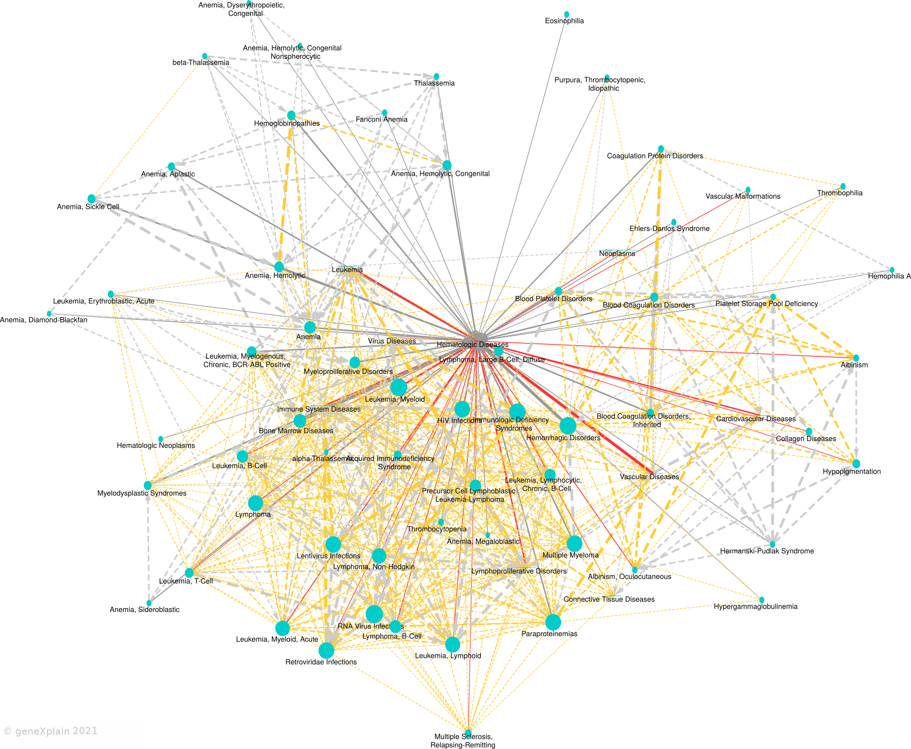
Graph analysis – introduction

Slide 4
Graph analysis
Definition: A graph is a non-linear data structure consisting of nodes (also called vertices) and edges that connect them. Think of a graph as a network of interconnected objects, where each object is a node, and the connections between them are edges.
Types of Graphs:
Undirected Graph: A graph where edges do not have direction. For example, a friendship network where two people are friends with each other.
Directed Graph: A graph where edges have direction. For example, a social media network where one person follows another.
Weighted Graph: A graph where edges have weights or values associated with them. For example, a road network where edges represent distances between cities.
Unweighted Graph: A graph where edges do not have weights or values associated with them. For example, a simple friendship network.

Slide 5
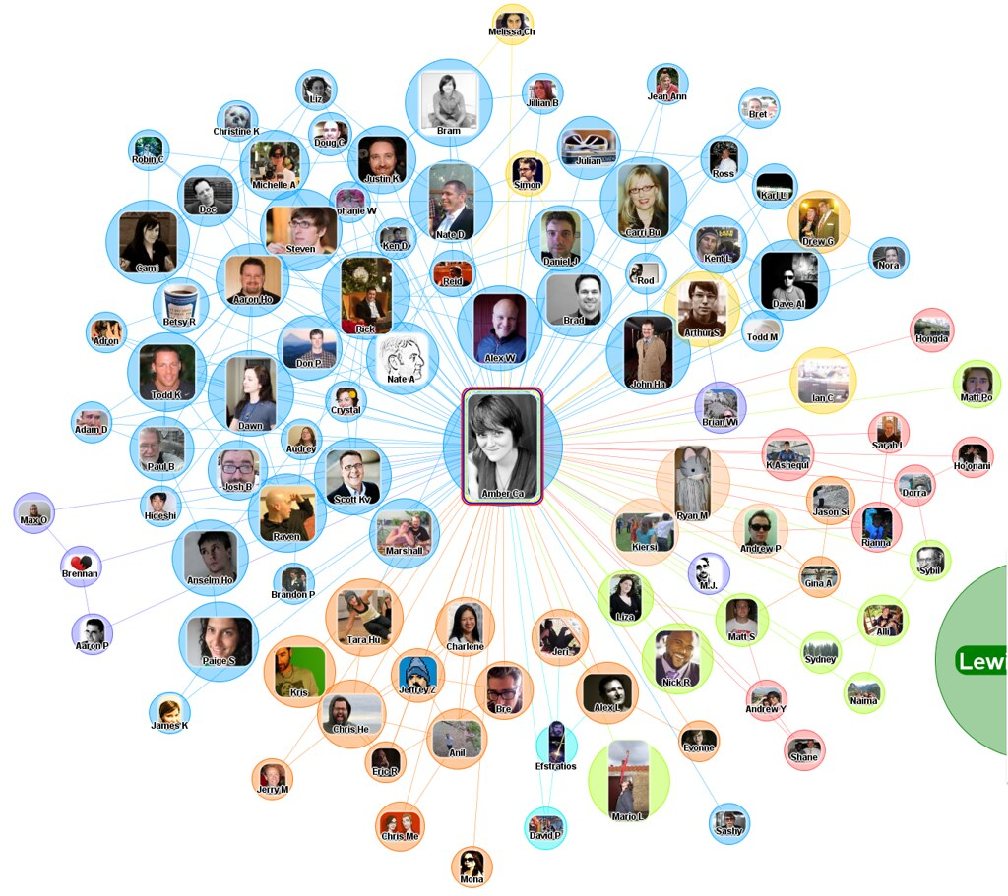
Graph analysis
Undirected Graph Example
Friendship Network

Slide 6
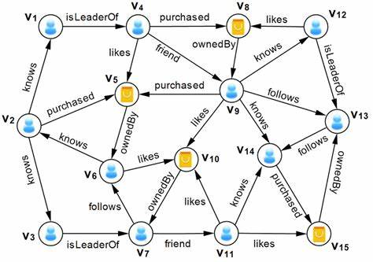
Graph analysis
Directed Graph Example
Social Shopping Network

Slide 7
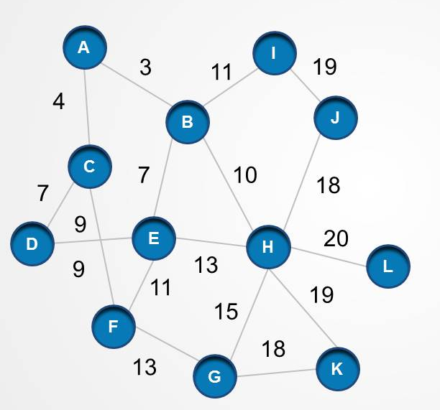
Graph analysis
Directed Graph Example
Road Network

Slide 8
Graph analysis
Graph Analytics Concepts
Node Degree: The number of edges connected to a node.
Edge Weight: The value or weight associated with an edge.
Shortest Path: The minimum number of edges required to travel between two nodes.
Clustering Coefficient: A measure of how closely connected a node is to its neighbours.
Centrality Measures: Measures of a node's importance or influence in the graph, such as PageRank or Betweenness Centrality.

Slide 9
Graph analysis
Graph Analytics Techniques
Graph Search: Finding a specific node or path in a graph.
Graph traversal to explore all nodes connected to a certain node.
Finding shortest paths between nodes.
Detecting communities or clusters of nodes that are densely connected.
Identifying important nodes using centrality measures (like PageRank).
Graph Clustering: Grouping similar nodes together based on their connections.
Graph Embeddings: Representing nodes as vectors in a high-dimensional space to capture their relationships.

Slide 10
Graph analysis
Real-World Applications
Social Network Analysis: Analyzing relationships between people in social media networks.
Recommendation Systems: Recommending products or services based on user behaviour and preferences.
Traffic Optimization: Optimizing traffic flow in transportation networks.
Network Security: Identifying vulnerabilities in computer networks.
Biological Network Analysis: Analyzing relationships between genes, proteins, and other biological molecules.

Slide 11
Graph analysis
Graph Analysis using Apache Spark
Apache Spark GraphX, GraphFrames: A graph processing engine built on top of Apache Spark.
Feature | GraphX | GraphFrames
Underlying Structure | RDD-based | DataFrame-based
API Level | Lower-level | Higher-level, more user-friendly
Performance | Optimized for graph-parallel computations | Leverages DataFrame optimizations
Complex Queries | More manual; requires RDD manipulations | Supports SQL-like queries
Ease of Use | More complex for beginners | Easier for users familiar with DataFrames
Graph Algorithms | Basic algorithms provided | Rich set of algorithms with easier access

Slide 12
Graph analysis
Lab practice

